Slide 1




Calculation Policy
Subtraction – Years 4-6

Slide 2
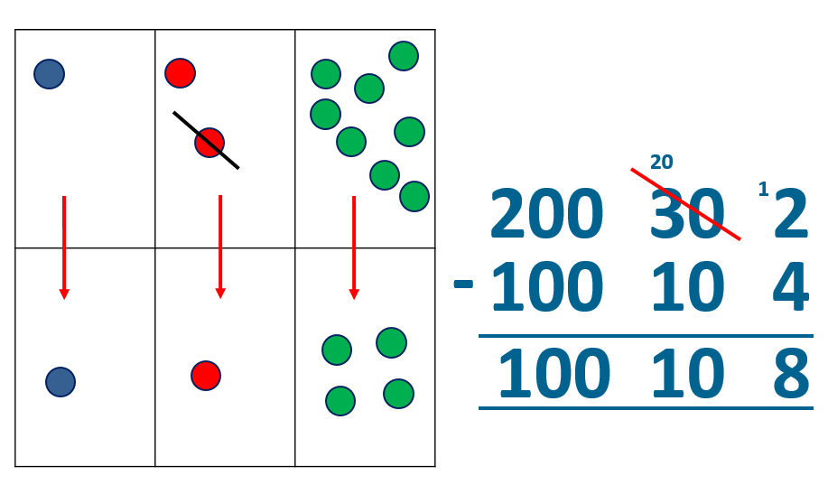
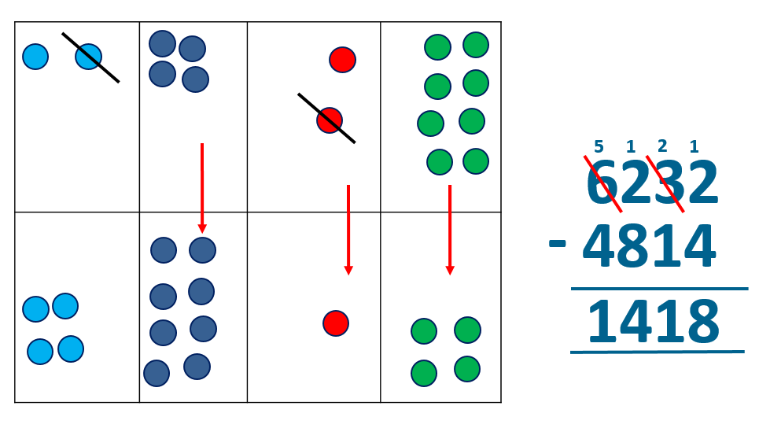
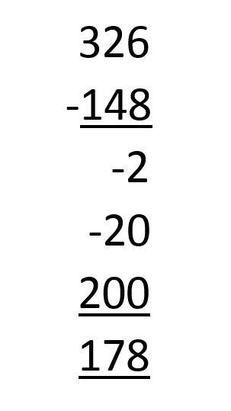
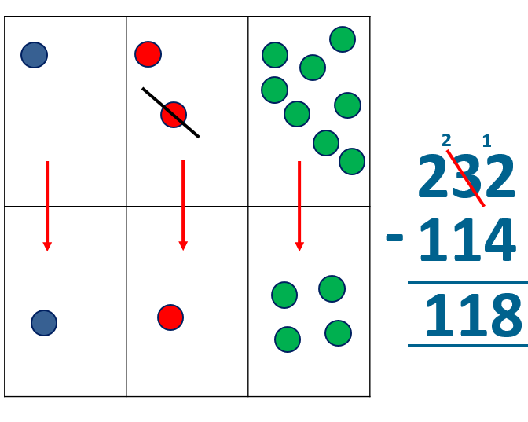
Year 4 | Year 5 | Year 6
Missing number/digit problems: 456 + □ = 710; 1□7 + 6□ = 200; 60 + 99 + □ = 340; 200 – 90 – 80 = □; 225 - □ = 150; □ – 25 = 67; 3450 – 1000 = □; □ - 2000 = 900 Mental methods should continue to develop, supported by a range of models and images, including the number line. The bar model should continue to be used to help with problem solving. Written methods (progressing to 4-digits) Expanded column subtraction with decomposition, modelled with place value counters, progressing to calculations with 4-digit numbers. If understanding of the expanded method is secure, children will move on to the formal method of decomposition, which again can be initially modelled with place value counters. | Missing number/digit problems: 6.45 = 6 + 0.4 + □; 119 - □ = 86; 1 000 000 - □ = 999 000; 600 000 + □ + 1000 = 671 000; 12 462 – 2 300 = □ Mental methods should continue to develop, supported by a range of models and images, including the number line. The bar model should continue to be used to help with problem solving. Written methods (progressing to more than 4-digits) When understanding of the expanded method is secure, children will move on to the formal method of decomposition, which can be initially modelled with place value counters. Progress to calculating with decimals, including those with different numbers of decimal places. | Missing number/digit problems: □ and # each stand for a different number. # = 34. # + # = □ + □ + #. What is the value of □? What if # = 28? What if # = 21 10 000 000 = 9 000 100 + □ 7 – 2 x 3 = □; (7 – 2) x 3 = □; (□ - 2) x 3 = 15 Mental methods should continue to develop, supported by a range of models and images, including the number line. The bar model should continue to be used to help with problem solving. Written methods As year 5, progressing to larger numbers, aiming for both conceptual understanding and procedural fluency with decomposition to be secured. Teachers may also choose to introduce children to other efficient written layouts which help develop conceptual understanding. For example: Continue calculating with decimals, including those with different numbers of decimal places.
Obj
Gui
Vid
Ex
Obj
Gui
Vid
Ex
Obj
Gui
Vid
Ex

Slide 3
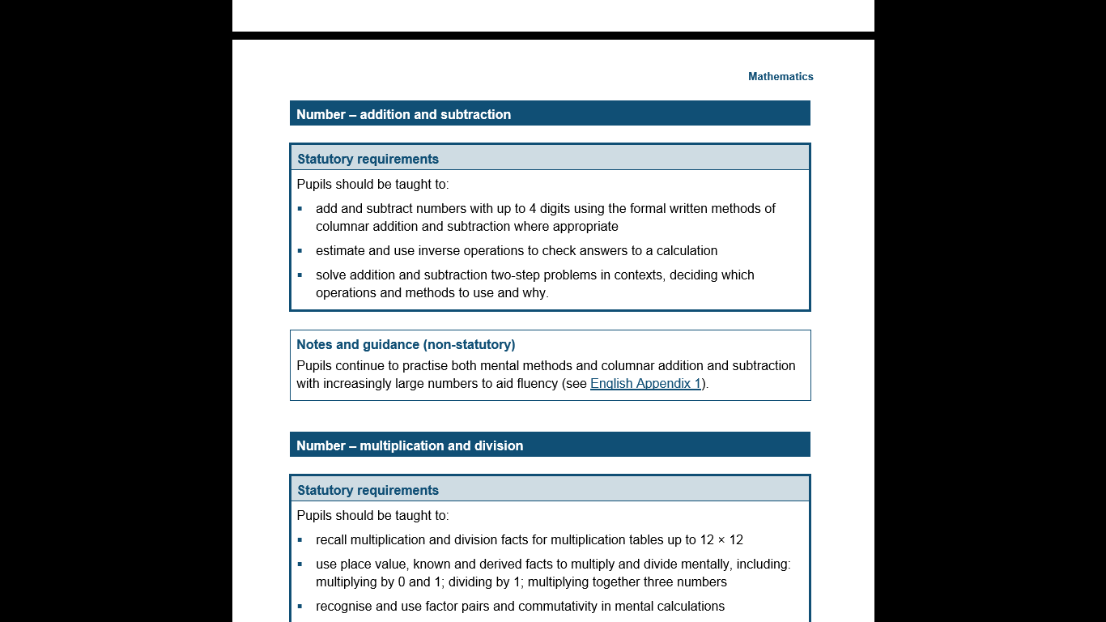
The National Curriculum in England. ©Crown Copyright 2013
Year 4 objectives
Return

Slide 4
The National Curriculum in England. ©Crown Copyright 2013
Year 4 guidance
Return

Slide 5
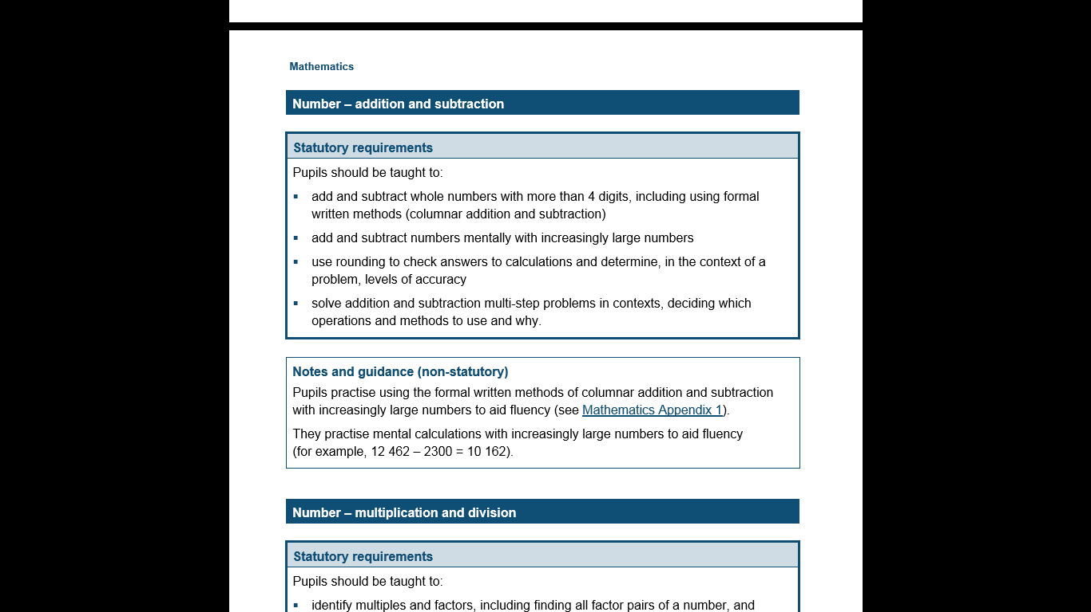
The National Curriculum in England. ©Crown Copyright 2013
Year 5 objectives
Return

Slide 6
The National Curriculum in England. ©Crown Copyright 2013
Year 5 guidance
Return

Slide 7
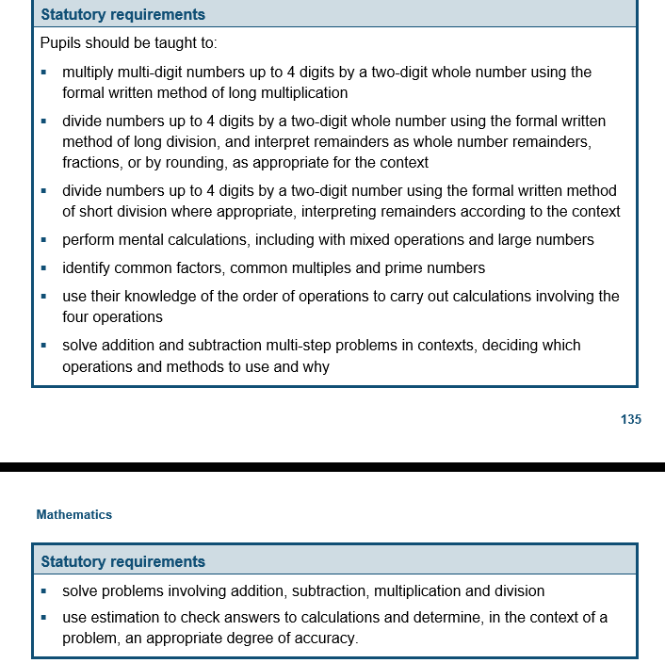
The National Curriculum in England. ©Crown Copyright 2013
Year 6 objectives
Return

Slide 8
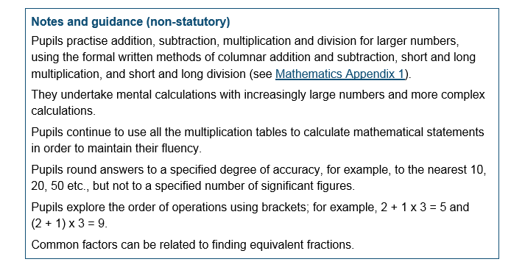
The National Curriculum in England. ©Crown Copyright 2013
Year 6 guidance
Return

