Slide 1
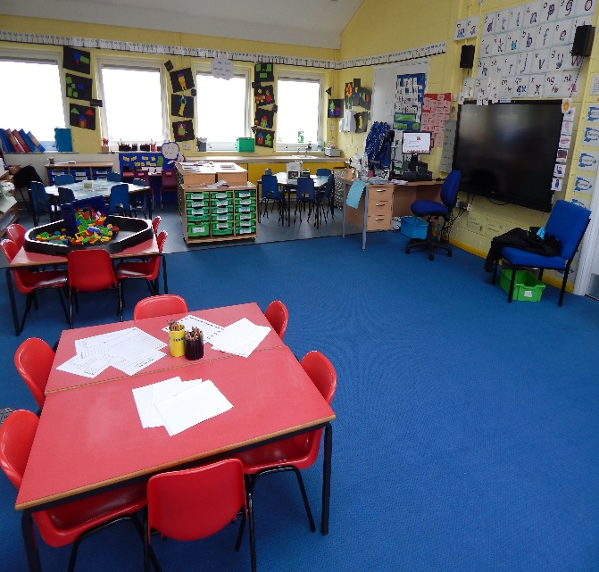
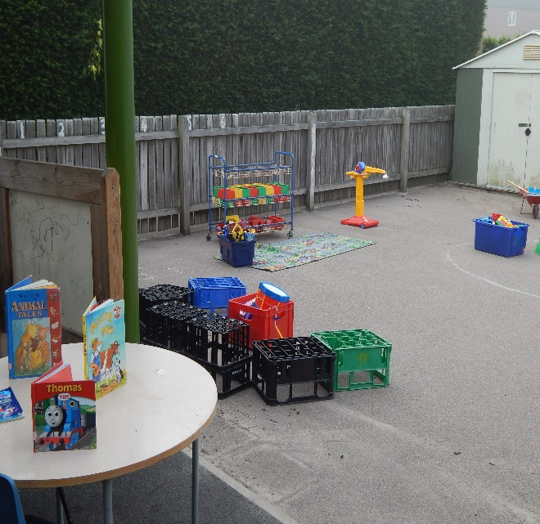
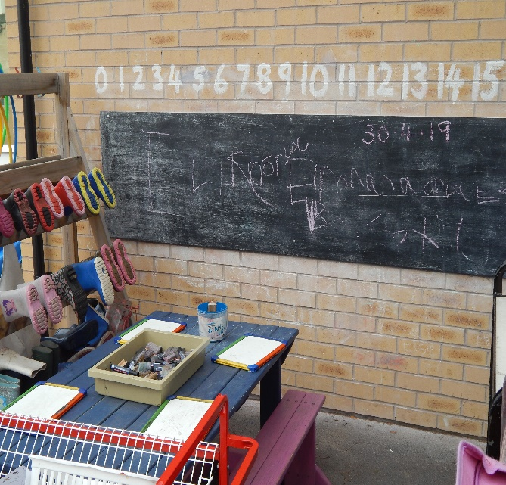
Early Years Curriculum
Seven areas of learning
Play based and topic approach to learning

Slide 2
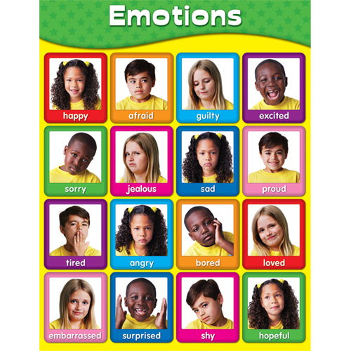
Personal, Social and Emotional Development
Independence
School routines
Cooperation
Self confidence and self awareness
Positive relationships with adults and children
Positive attitudes to school and learning

Slide 3


Physical Development
Healthy development
Using small and large equipment
Self care
Pencil control
Dressing

Slide 4
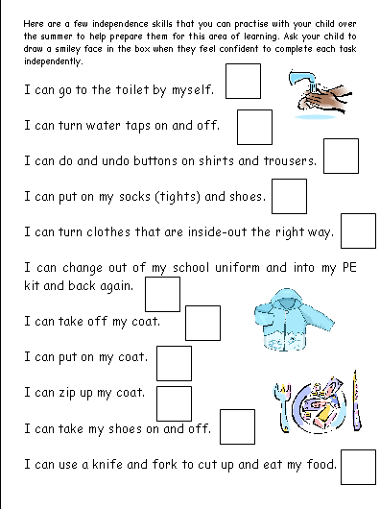
Developing self care

Slide 5

Communication and Language Development
Listening and attention
Speaking
Understanding

Slide 6
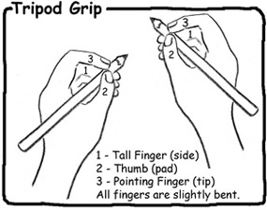
Literacy
Phonics
c – a - t
Reading
Writing
Thomas

Slide 7
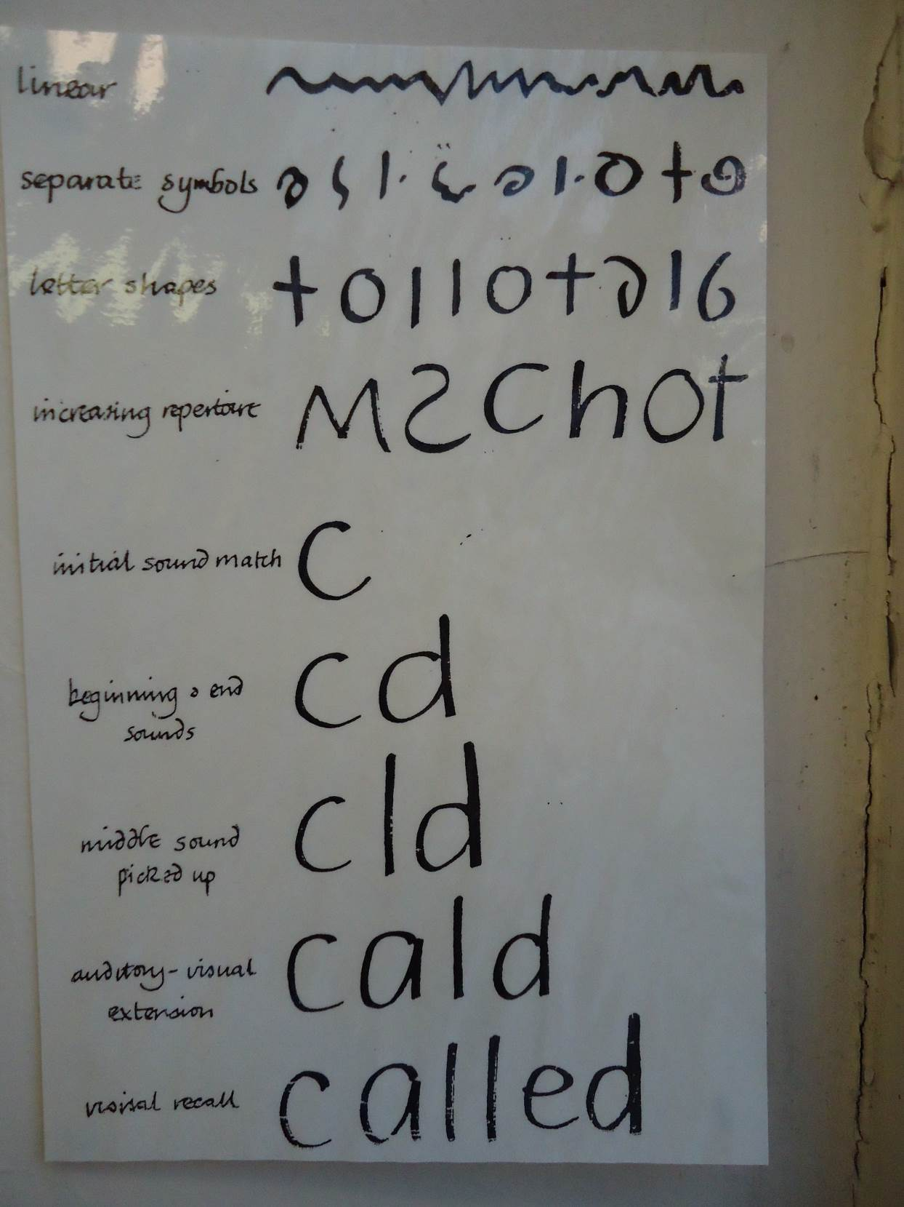

Slide 8
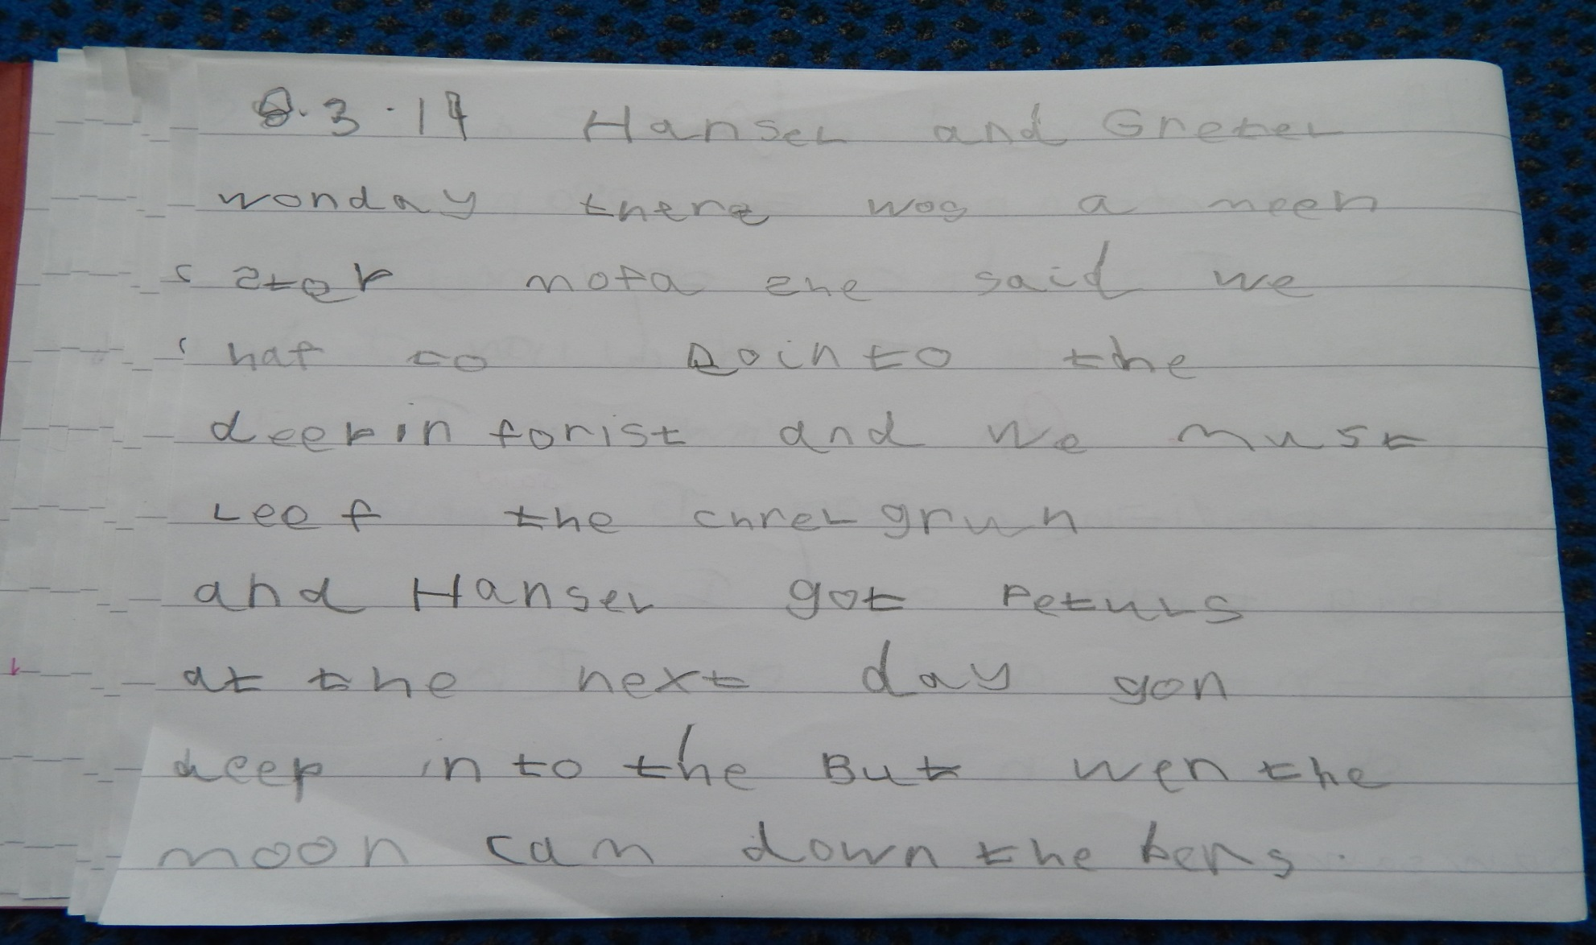

Slide 9
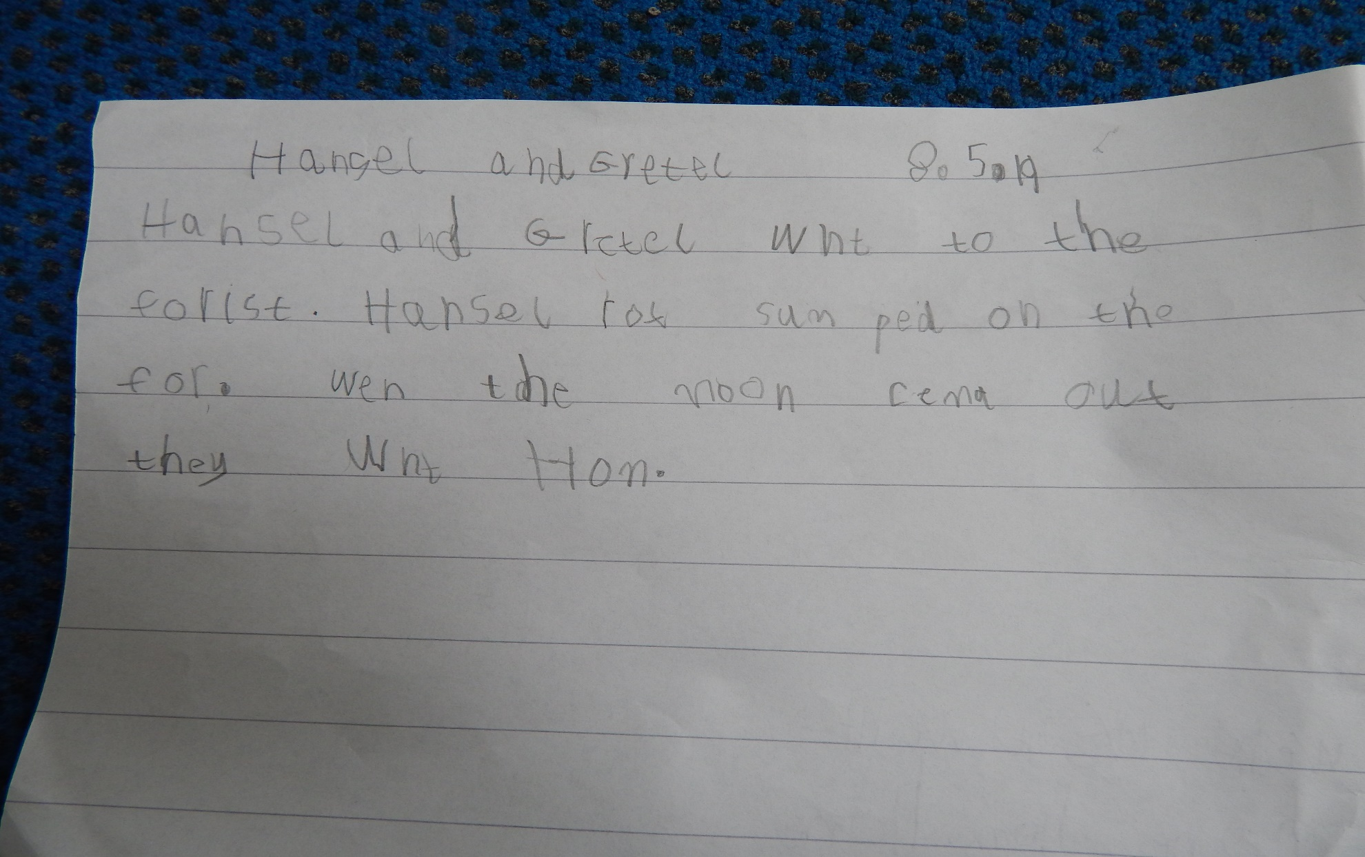

Slide 10
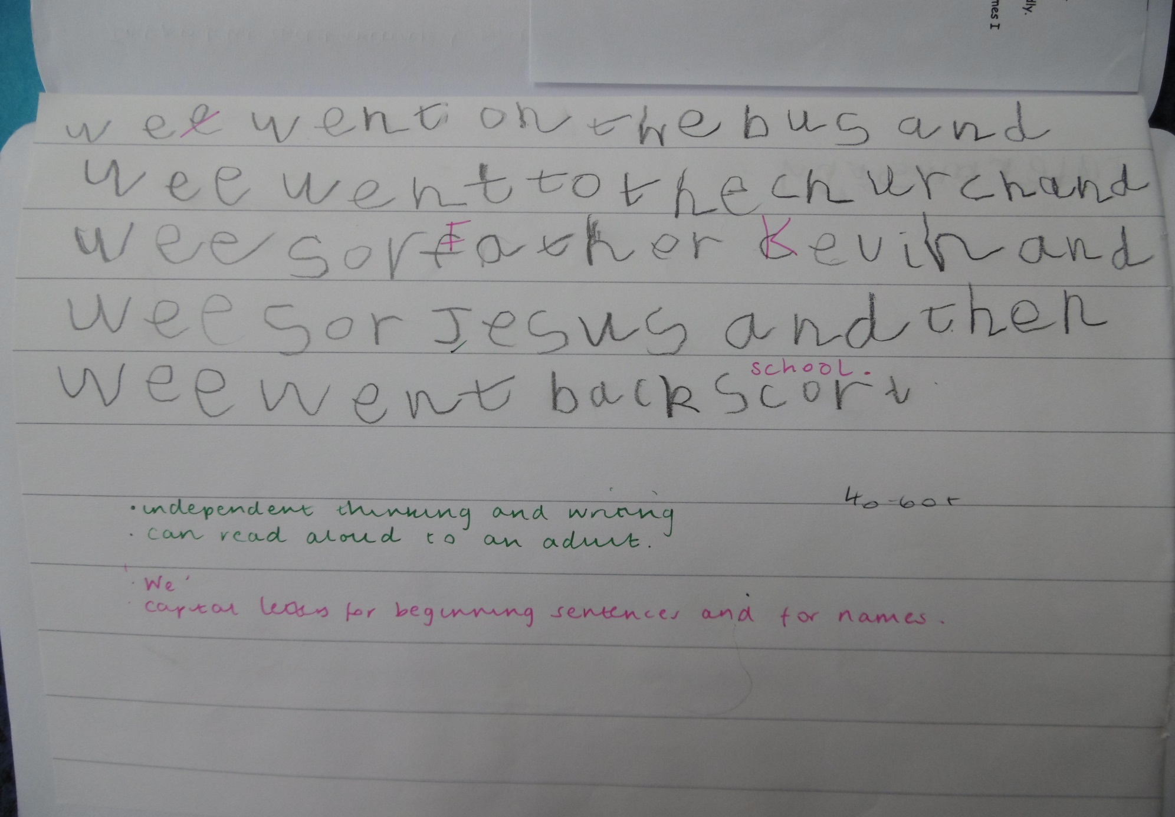

Slide 11
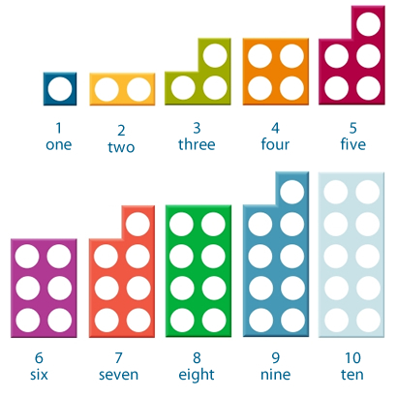


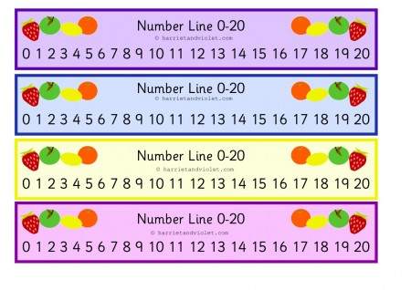
Mathematics
Counting
Calculations
Patterns and Shapes

Slide 12

Understanding the World
Science
History
Geography
Religious Education
Computing

Slide 13
Expressive Arts and Design
Music
Art
Role Play
Design and Technology
Story Telling
Writing

Slide 14
Assessment
Observations
Learning Journeys
Foundation Stage Profile

