Slide 1
Calculation Policy Multiplication – Years 1-3

Slide 2
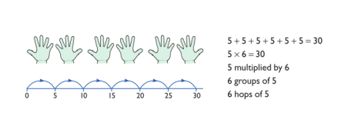
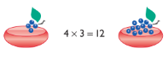
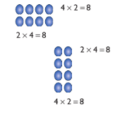
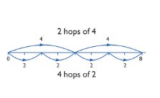
Year 1 | Year 2 | Year 3
Understand multiplication is related to doubling and combing groups of the same size (repeated addition) Washing line, and other practical resources for counting. Concrete objects. Numicon; bundles of straws, bead strings Problem solving with concrete objects (including money and measures Use cuissenaire and bar method to develop the vocabulary relating to ‘times’ – Pick up five, 4 times Use arrays to understand multiplication can be done in any order (commutative) | Expressing multiplication as a number sentence using x Using understanding of the inverse and practical resources to solve missing number problems. 7 x 2 = = 2 x 7 7 x = 14 14 = x 7 x 2 = 14 14 = 2 x x ⃝ = 14 14 = x ⃝ Develop understanding of multiplication using array and number lines (see Year 1). Include multiplications not in the 2, 5 or 10 times tables. Begin to develop understanding of multiplication as scaling (3 times bigger/taller) Doubling numbers up to 10 + 10 Link with understanding scaling Using known doubles to work out double 2d numbers (double 15 = double 10 + double 5) Towards written methods Use jottings to develop an understanding of doubling two digit numbers. 16 10 6 x2 x2 20 12 | Missing number problems Continue with a range of equations as in Year 2 but with appropriate numbers. Mental methods Doubling 2 digit numbers using partitioning Demonstrating multiplication on a number line – jumping in larger groups of amounts 13 x 4 = 10 groups 4 = 3 groups of 4 Written methods (progressing to 2d x 1d) Developing written methods using understanding of visual images Develop onto the grid method Give children opportunities for children to explore this and deepen understanding using Dienes apparatus and place value counters
Obj
Gui
Ex
Obj
Gui
Vid
Ex
Obj
Gui
Vid
Ex

Slide 3
The National Curriculum in England. ©Crown Copyright 2013 Year 1 objectives
Return

Slide 4
The National Curriculum in England. ©Crown Copyright 2013 Year 1 guidance
Return

Slide 5
The National Curriculum in England. ©Crown Copyright 2013 Year 2 objectives
Return

Slide 6
The National Curriculum in England. ©Crown Copyright 2013 Year 2 guidance
Return

Slide 7
The National Curriculum in England. ©Crown Copyright 2013 Year 3 objectives
Return

Slide 8
The National Curriculum in England. ©Crown Copyright 2013 Year 3 guidance
Return

