Slide 1
Calculation Policy Division – Years 4-6

Slide 2
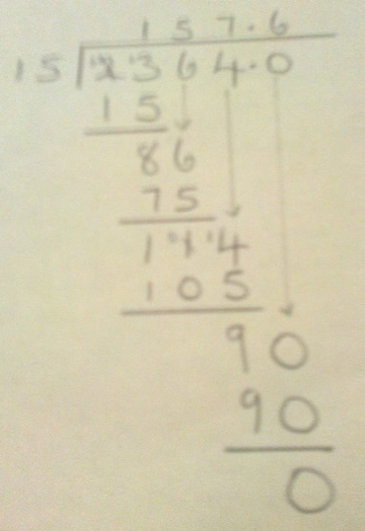
Year 4 | Year 5 | Year 6
÷ = signs and missing numbers Continue using a range of equations as in year 3 but with appropriate numbers. Sharing, Grouping and using a number line Children will continue to explore division as sharing and grouping, and to represent calculations on a number line until they have a secure understanding. Children should progress in their use of written division calculations: Using tables facts with which they are fluent Experiencing a logical progression in the numbers they use, for example: Dividend just over 10x the divisor, e.g. 84 ÷ 7 Dividend just over 10x the divisor when the divisor is a teen number, e.g. 173 ÷ 15 (learning sensible strategies for calculations such as 102 ÷ 17) Dividend over 100x the divisor, e.g. 840 ÷ 7 Dividend over 20x the divisor, e.g. 168 ÷ 7 All of the above stages should include calculations with remainders as well as without. Remainders should be interpreted according to the context. (i.e. rounded up or down to relate to the answer to the problem) |  | ÷ = signs and missing numbers Continue using a range of equations but with appropriate numbers Sharing and Grouping and using a number line Children will continue to explore division as sharing and grouping, and to represent calculations on a number line as appropriate. Quotients should be expressed as decimals and fractions Formal Written Methods – long and short division E.g. 1504 ÷ 8 E.g. 2364 ÷ 15
Formal Written Methods Formal short division should only be introduced once children have a good understanding of division, its links with multiplication and the idea of ‘chunking up’ to find a target number (see use of number lines above) Short division to be modelled for understanding using place value counters as shown below. Calculations with 2 and 3-digit dividends. E.g. fig 1 | Formal Written Methods Continued as shown in Year 4, leading to the efficient use of a formal method. The language of grouping to be used (see link from fig. 1 in Year 4) E.g. 1435 ÷ 6 Children begin to practically develop their understanding of how express the remainder as a decimal or a fraction. Ensure practical understanding allows children to work through this (e.g. what could I do with this remaining 1? How could I share this between 6 as well?)
Obj
Gui
Vid
Ex
Obj
Gui
Vid
Ex
Obj
Gui
Vid
Ex
Jottings
7 x 100 = 700
7 x 10 = 70
7 x 20 = 140
e.g. 840 ÷ 7 = 120
100 groups
20 groups
0
700
840

Slide 3
The National Curriculum in England. ©Crown Copyright 2013 Year 4 objectives
Return

Slide 4
The National Curriculum in England. ©Crown Copyright 2013 Year 4 guidance
Return

Slide 5
The National Curriculum in England. ©Crown Copyright 2013 Year 5 objectives
Return

Slide 6
The National Curriculum in England. ©Crown Copyright 2013 Year 5 guidance
Return

Slide 7
The National Curriculum in England. ©Crown Copyright 2013 Year 6 objectives
Return

Slide 8
The National Curriculum in England. ©Crown Copyright 2013 Year 6 guidance
Return

