Slide 1
Crich 2022
Parents’ meeting

Slide 2
Crich 2022
^{27th – 29th June 2022}

Slide 3
Crich
Traditionally, St John Fisher CVA has gone on residential to Crich for many years.
We stay at the Briars retreat centre.
This centre is run by youth workers for the Nottingham diocese.

Slide 4
The Briars
The Briars is a Catholic youth retreat centre based in the heart of the beautiful Derbyshire Dales. As part of the Nottingham Diocesan Catholic Youth Service it has been welcoming groups from all over the country for nearly 50 years. Living in community we explore what it means to be a Christian and part of the Catholic Church in the 21 st century. We use small group work, games, prayer, singing and outdoor activities to explore our faith, beliefs and values. We aim to journey with people towards a personal relationship with Christ, looking to recognise God in all things and all people and helping to make faith real and relevant for all.

Slide 5
Day Activities
Throughout the few days, we will go for a day out on the way and will be doing a mixture of educational, fun and adventurous activities.
Proposed activities...

Slide 6
Monday
Leicester Outdoor Pursuit Centre
We are hoping to leave SJF at approx. 8:30am and head straight to the Outdoor Pursuit Centre.
We will take part in 3 activities: zip lining, abseiling and the high ropes.
Children will need to bring a packed lunch with them.
We will arrive at The Briars at approx. 4:30pm.

Slide 7
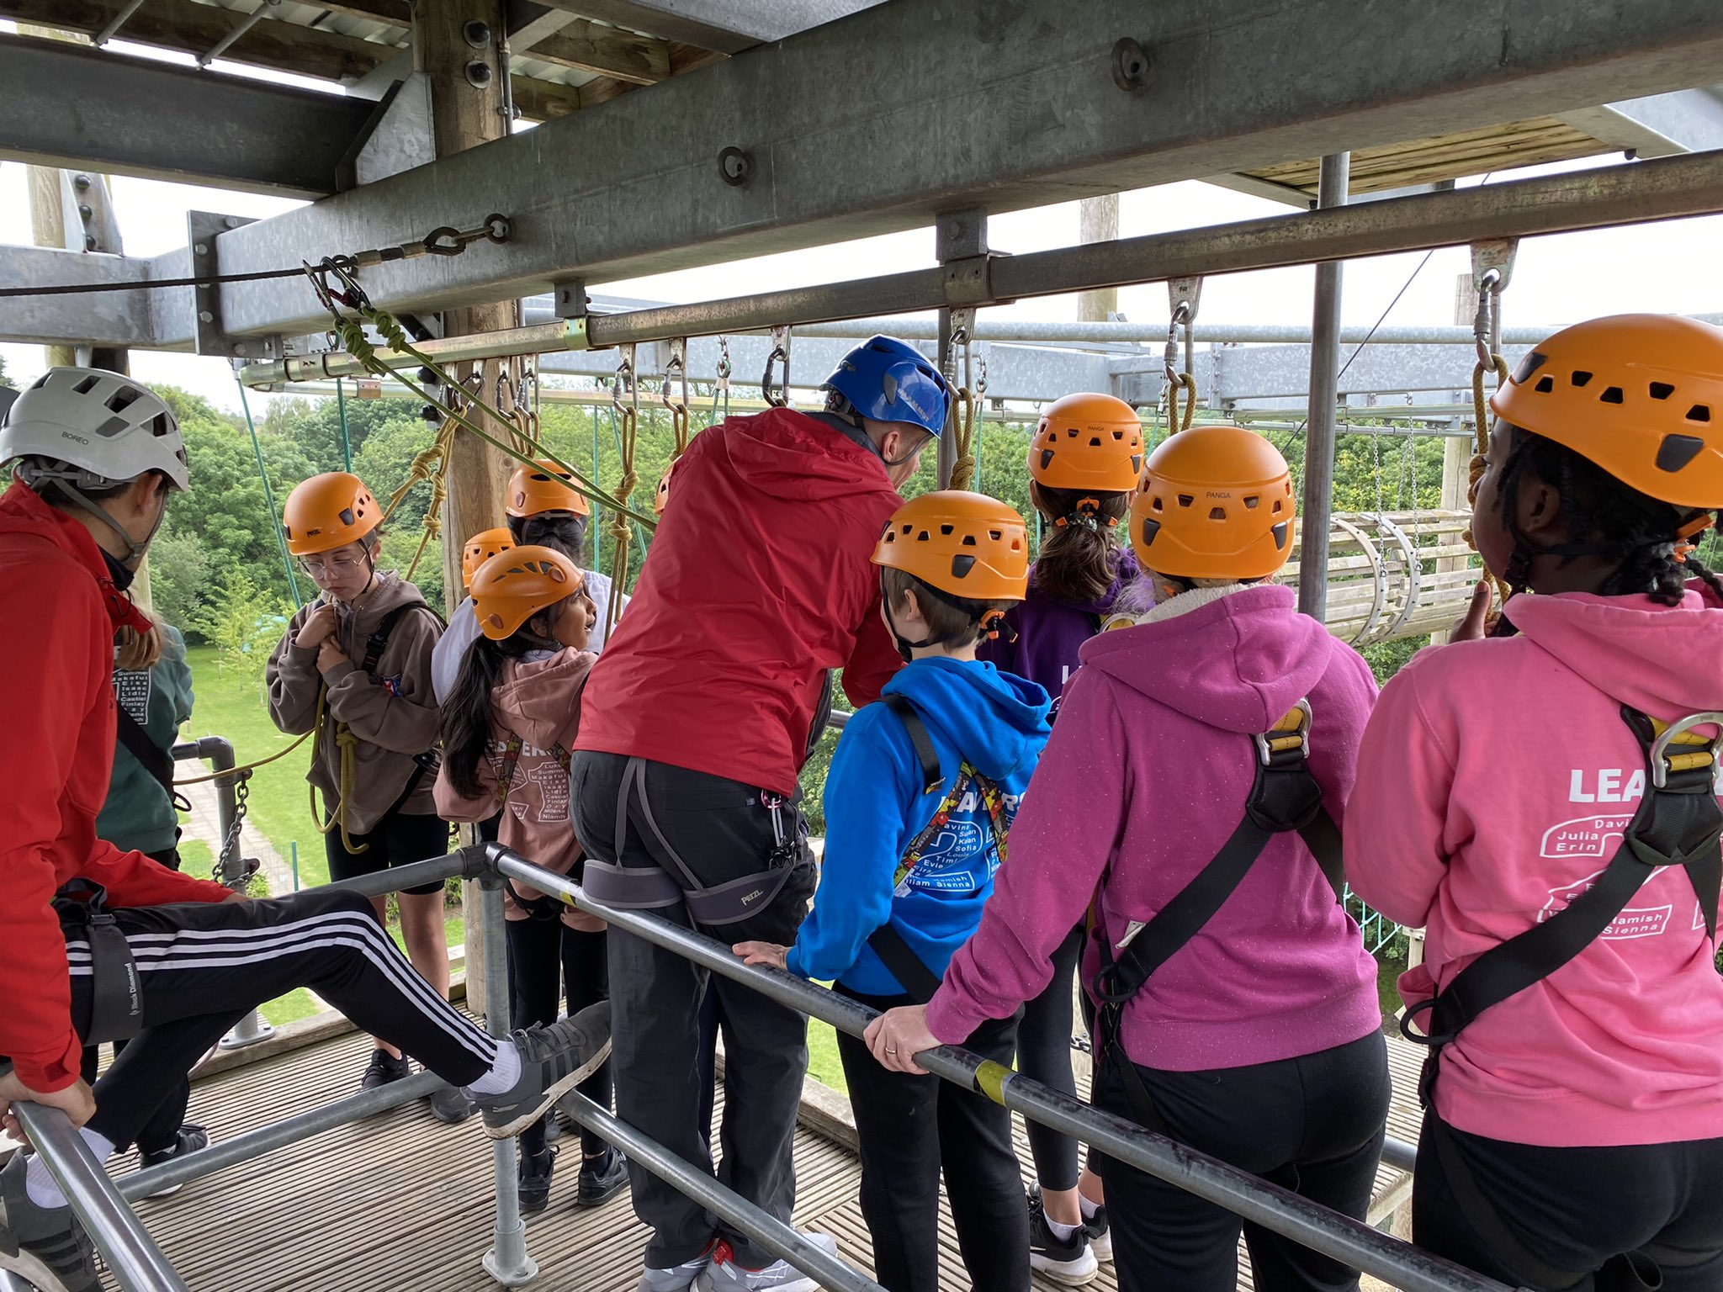
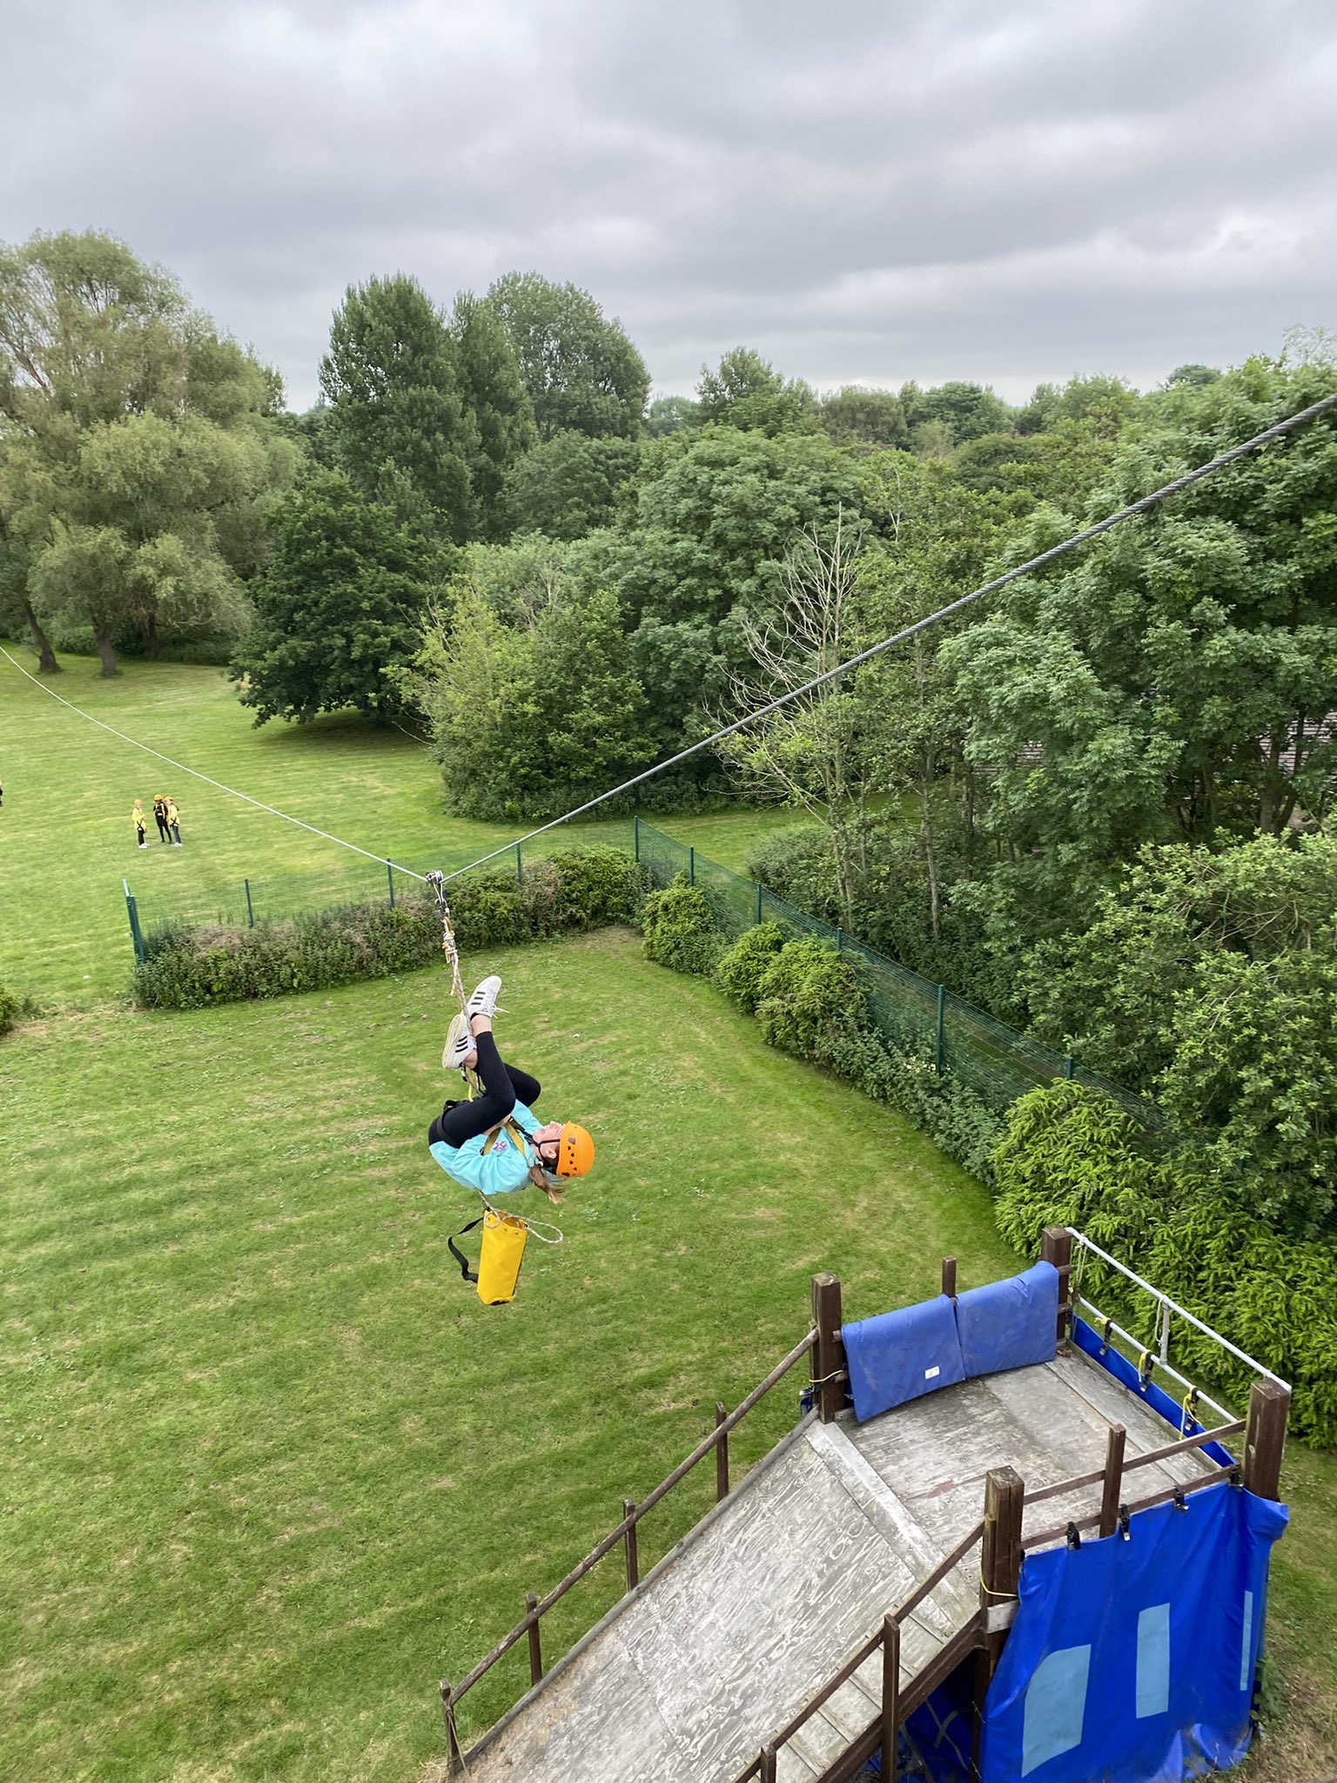
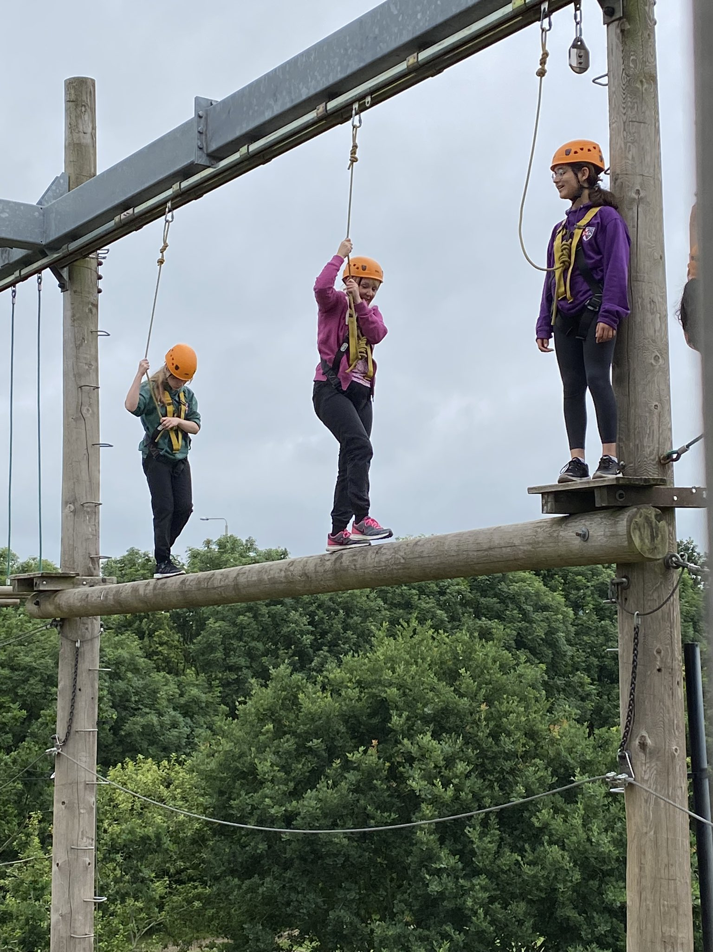
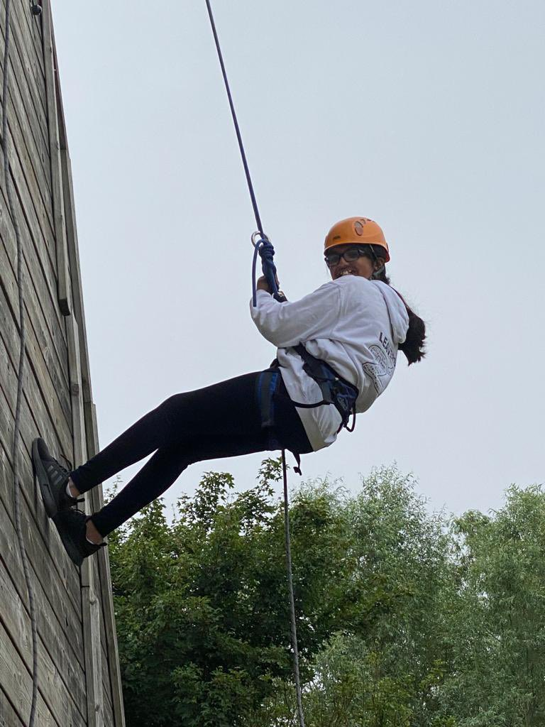
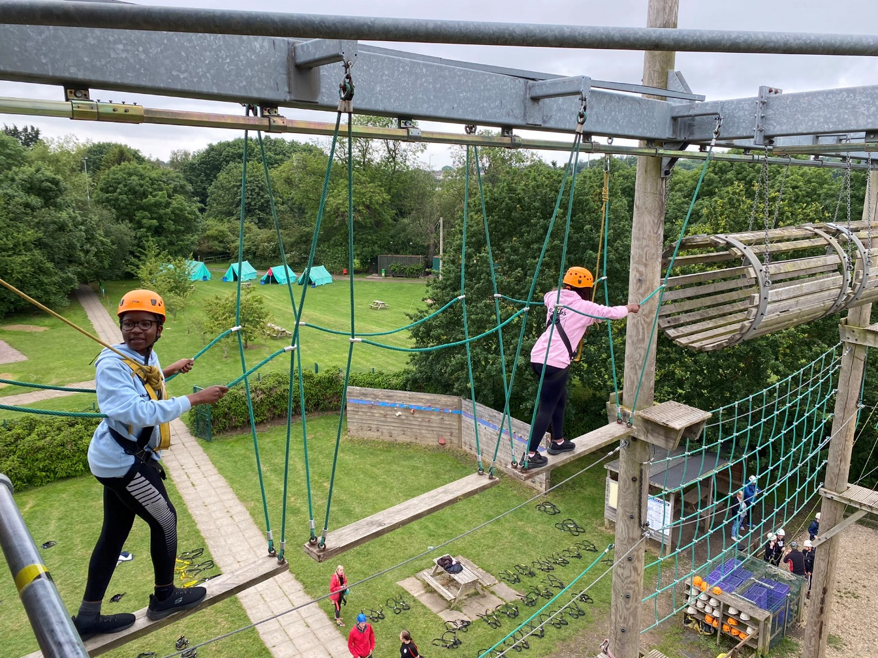

Slide 8
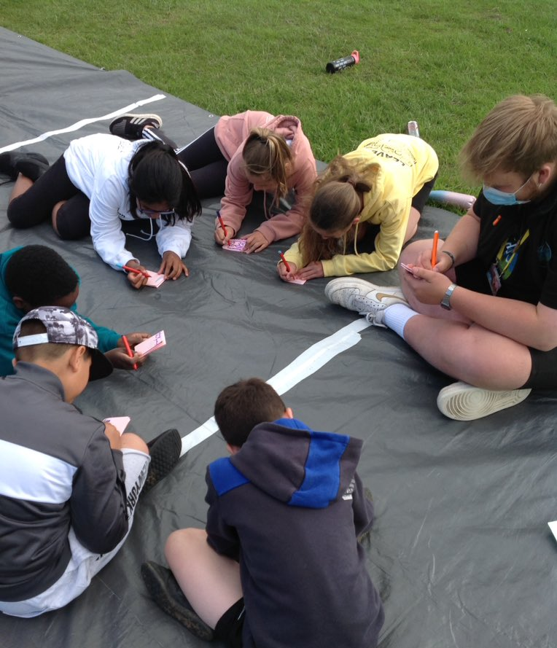
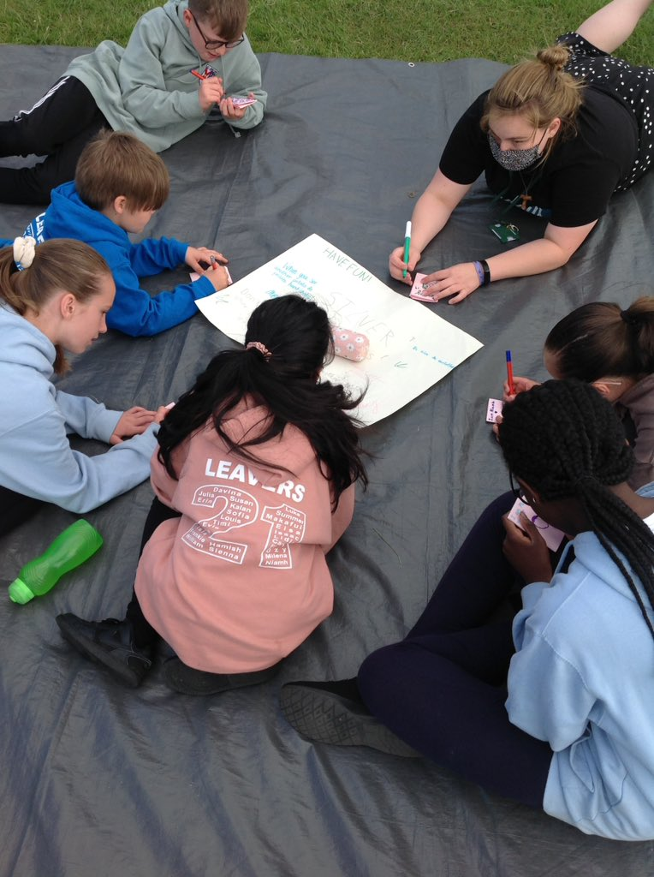
Tuesday– A day at the Briars with the team.
Themed on a topic of our choice.
Friendships
Change
Moving on
Our faith

Slide 9
Wednesday
A morning of activities with the Briars team and time to socialise before heading home at 1.30pm.
Hoping to arrive back at school by the end of the school day.

Slide 10
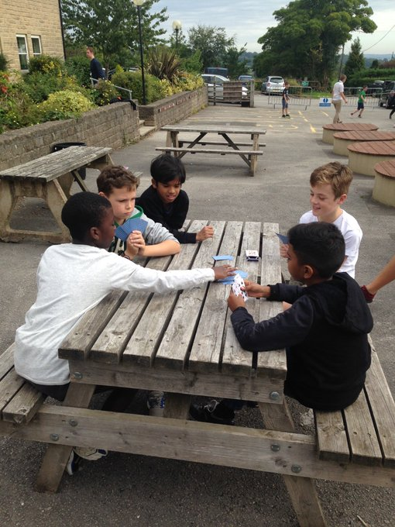
Evening Activities

Slide 11
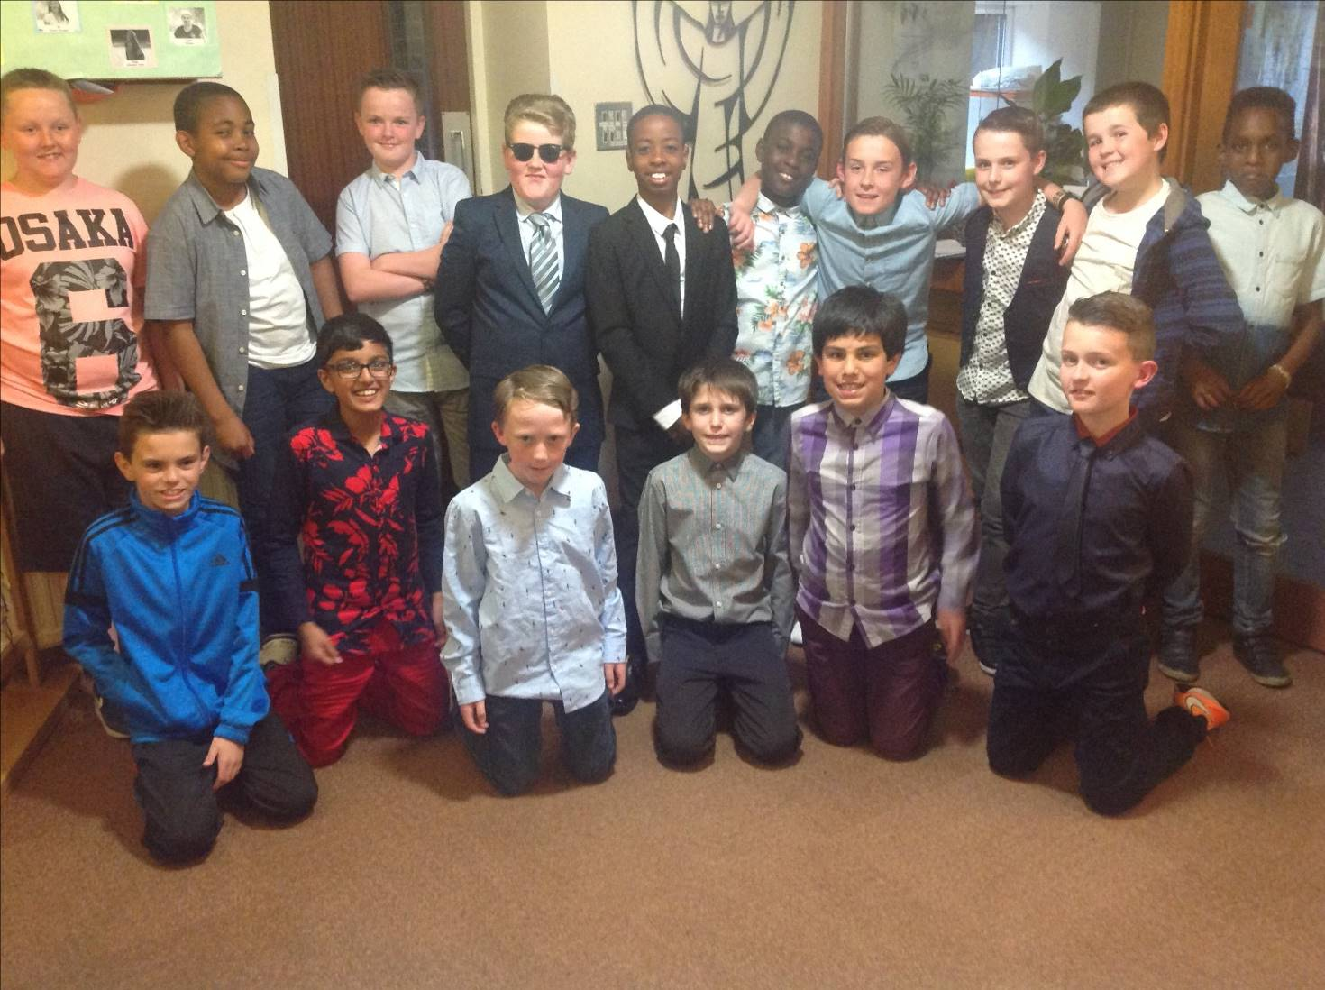

Slide 12
Kit list
Toiletries and a towel
Pyjamas and slippers (or indoor shoes)
Warm clothing just in case!
Sun cream and a hat
Waterproof coat
Shoes/boots (could get muddy)
Spending money for snacks/souvenirs in the tuck shop
Water bottle
Small rucksack (large enough to carry lunch and a waterproof

Slide 13
Some rules
No mobile phones, ipads, ipods
No contact unless emergency
Code of conduct

Slide 14
Other info
Sharing with other school
Separate dorms allocated on day of arrival. All rooms are locked and each child will have their own key card
All rooms are en-suite
All children and staff will be in the same building
Food is provided by The Briars (need to bring your own packed lunch on the Monday) – dietary requirements will be catered for
Medical – any medical requirements must be made known to staff
Staff – Miss Baraclough, Mrs Reilly and Mrs Johnson

Slide 15
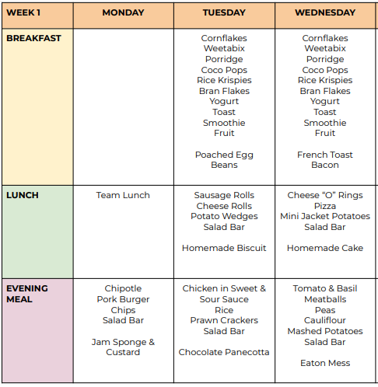
Sample menu

Slide 16
Provisional pricing
£155
Deposit £50
28th January 2022 – deposit
25th March 2022 – remaining balance
Can be paid in instalments or in full
£4 per day maximum for students spending money.

Slide 17
Overall
Children really enjoy the experience as it helps develop their individuality, their independence, their spirituality and their confidence as well as all having a tremendous time.
‘I visited the Briars this week with my class and St Patrick’s Y6 class, and it was one of the best experiences I have ever been on!’

Slide 18
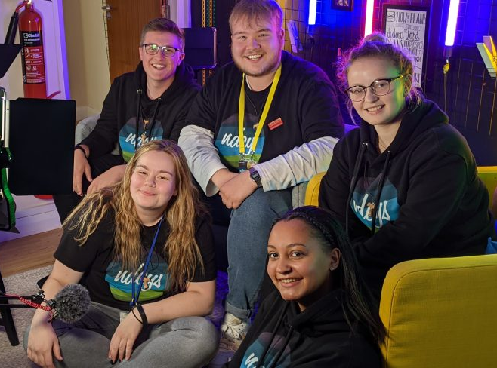
Any questions?

