Slide 1




Calculation Policy
Addition – Years 1-3

Slide 2

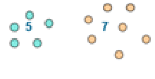
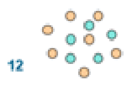

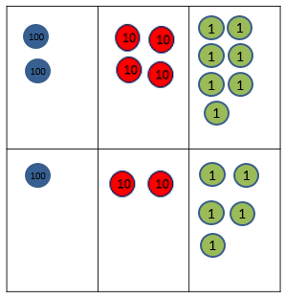


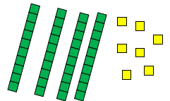
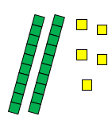
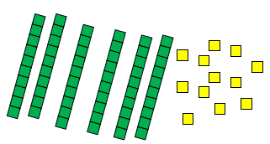
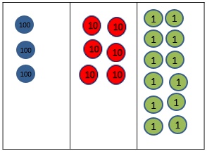
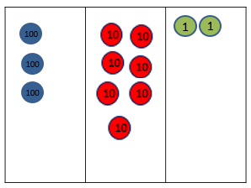
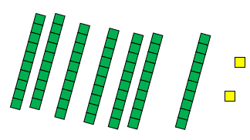


Year 1 | Year 2 | Year 3
+ = signs and missing numbers Children need to understand the concept of equality before using the ‘=’ sign. Calculations should be written either side of the equality sign so that the sign is not just interpreted as ‘the answer’. 2 = 1+ 1 2 + 3 = 4 + 1 Missing numbers need to be placed in all possible places. 3 + 4 = = 3 + 4 3 + = 7 7 = + 4 Counting and Combining sets of Objects Combining two sets of objects (aggregation) which will progress onto adding on to a set (augmentation) Understanding of counting on with a numbertrack. Understanding of counting on with a numberline (supported by models and images). 7+ 4 | Missing number problems e.g 14 + 5 = 10 + 32 + + = 100 35 = 1 + + 5 It is valuable to use a range of representations (also see Y1). Continue to use numberlines to develop understanding of: Counting on in tens and ones 23 + 12 = 23 + 10 + 2 = 33 + 2 = 35 Partitioning and bridging through 10. The steps in addition often bridge through a multiple of 10 e.g. Children should be able to partition the 7 to relate adding the 2 and then the 5. 8 + 7 = 15 Adding 9 or 11 by adding 10 and adjusting by 1 e.g. Add 9 by adding 10 and adjusting by 1 35 + 9 = 44 Towards a Written Method Partitioning in different ways and recombine 47+25 47 25 60 + 12 Leading to exchanging: 72 Expanded written method 40 + 7 + 20 + 5 = 40+20 + 7 + 5 = 60 + 12 = 72 | Missing number problems using a range of equations as in Year 1 and 2 but with appropriate, larger numbers. Partition into tens and ones Partition both numbers and recombine. Count on by partitioning the second number only e.g. 247 + 125 = 247 + 100 + 20+ 5 = 347 + 20 + 5 = 367 + 5 = 372 Children need to be secure adding multiples of 100 and 10 to any three-digit number including those that are not multiples of 10. Towards a Written Method Introduce expanded column addition modelled with place value counters (Dienes could be used for those who need a less abstract representation) Leading to children understanding the exchange between tens and ones. Some children may begin to use a formal columnar algorithm, initially introduced alongside the expanded method. The formal method should be seen as a more streamlined version of the expanded method, not a new method.
Obj
Gui
Vid
Ex
Obj
Gui
Vid
Ex
Obj
Gui
Vid
Ex

Slide 3
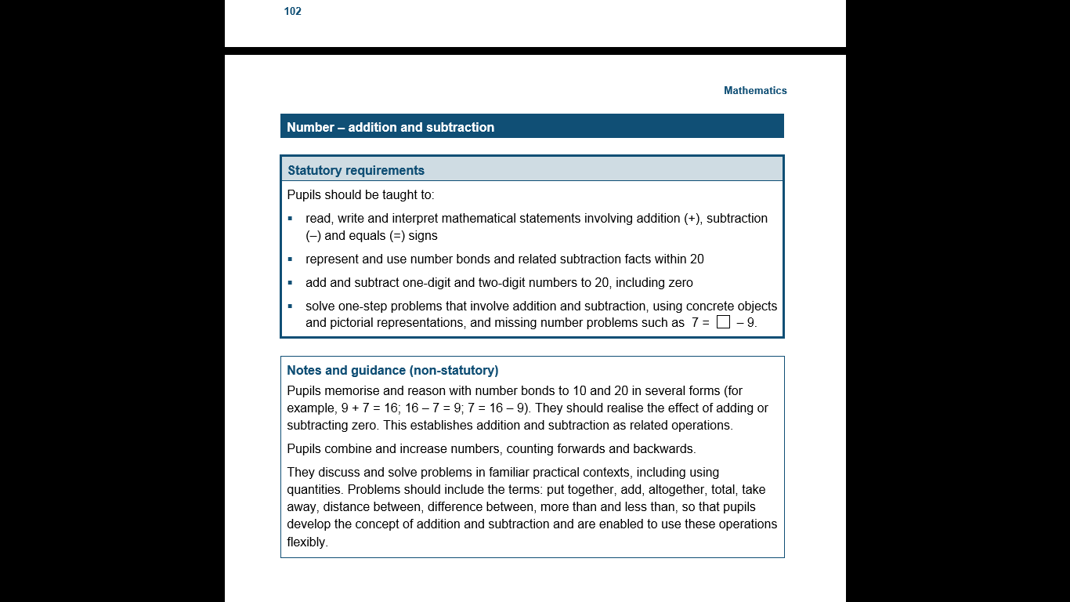
The National Curriculum in England. ©Crown Copyright 2013
Year 1 objectives
Return

Slide 4
The National Curriculum in England. ©Crown Copyright 2013
Year 1 guidance
Return

Slide 5
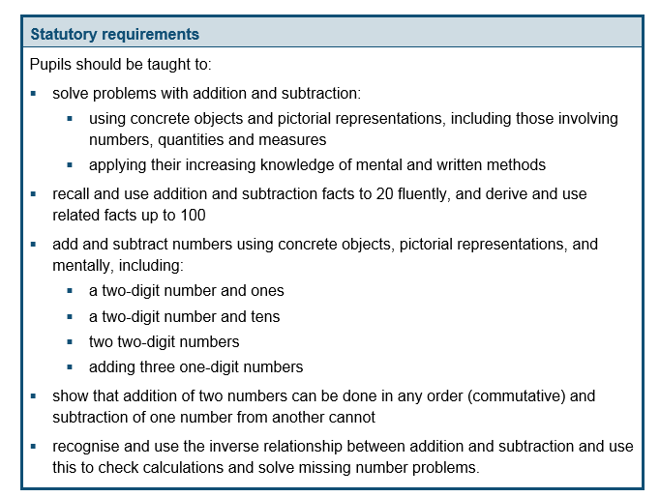
The National Curriculum in England. ©Crown Copyright 2013
Year 2 objectives
Return

Slide 6
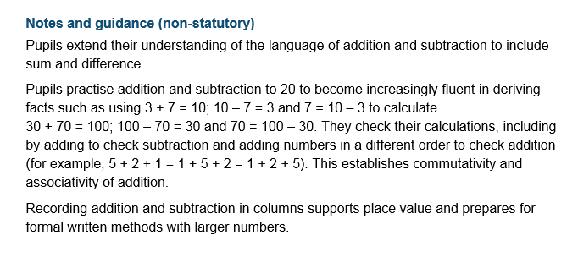
The National Curriculum in England. ©Crown Copyright 2013
Year 2 guidance
Return

Slide 7
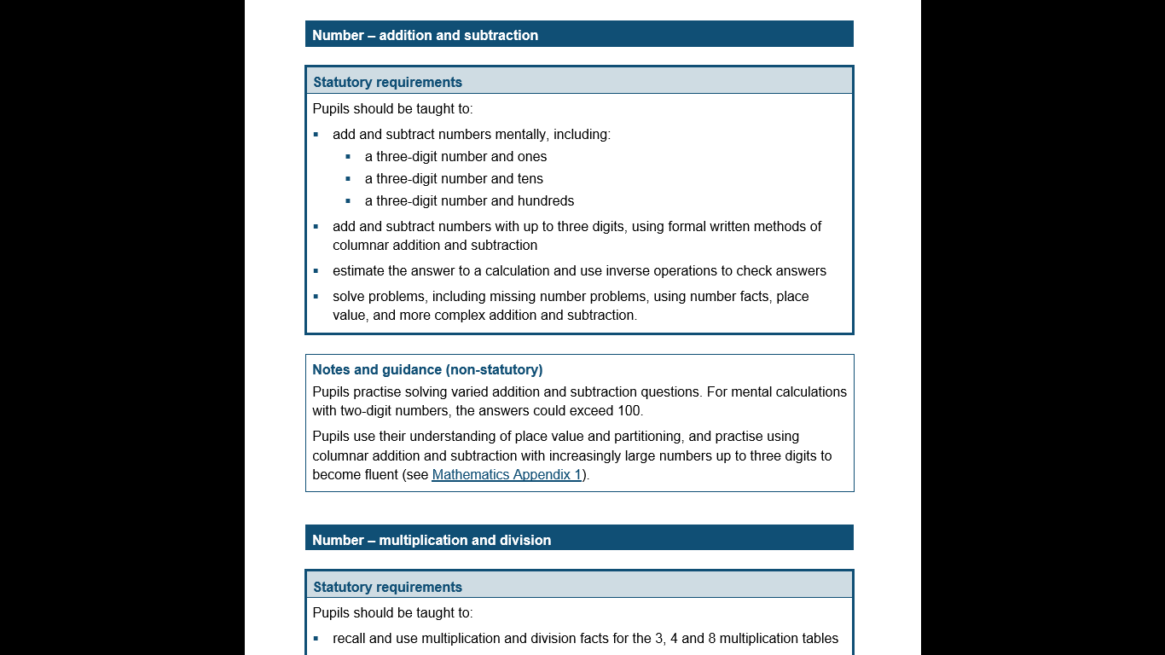
The National Curriculum in England. ©Crown Copyright 2013
Year 3 objectives
Return

Slide 8
The National Curriculum in England. ©Crown Copyright 2013
Year 3 guidance
Return

